Slide 1
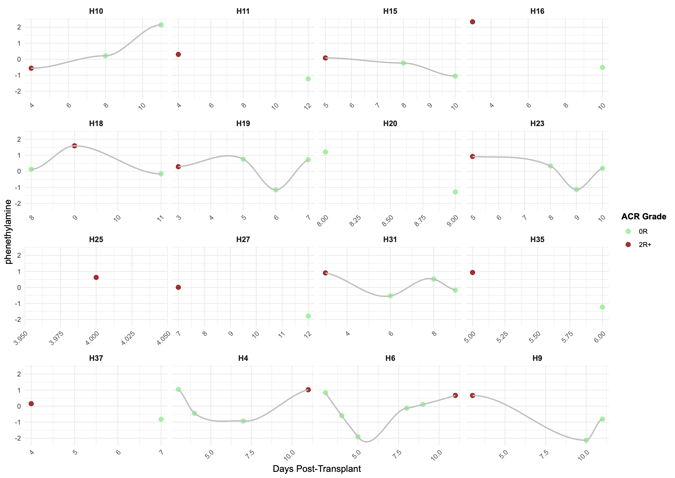
Repeated measures: Phenethylamine
Sample Number

Slide 2
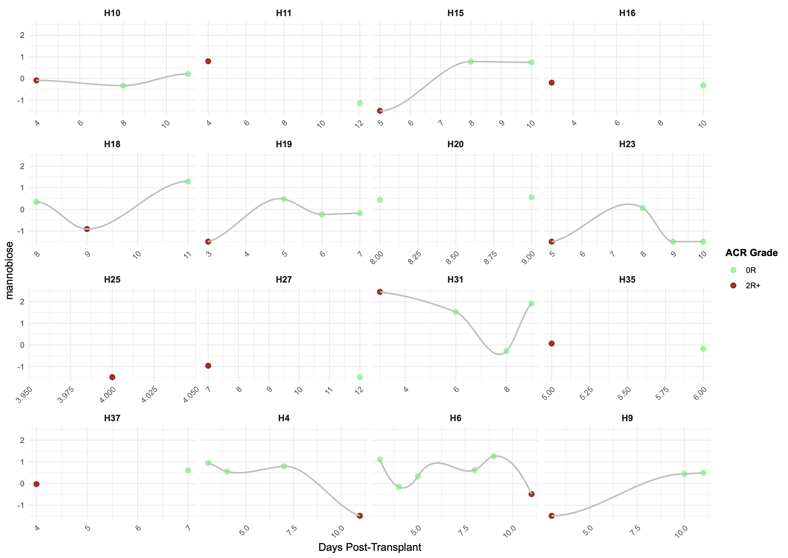
Repeated measures: Mannobiose
Sample Number

